Slide 1



UIDAI PROJECT
Use of Technology in increasing Efficiency ,Transparency and Delivery
Prince Raj 2015UCP1447
Shashank Goyal 2015UCP1425

Slide 2
UIDAI
UIDAI-Unique Identification Authority of India
UIDAI is an agency of the Government of India responsible for implementing the AADHAAR scheme ,a unique identification (UID) project.

Slide 3
Introduction :
It was established in february,2009.
The agency is headed by a chairman,who holds a cabinet rank
It provides a unique id number of 12 digits.
It will maintain the database of residents containing biometric and other data.
Current CEO of the UIDAI is Mr. Ajay Bhushan Pandey.

Slide 4
Need for UID :
Issues with the existing system:
Multiple identity cards for a single person. No unique identity in India like the SSN in the USA.
Duplication of identity cards.
Possibility of passport being lost or damaged. But its necessary to carry passport for abroad travel.
Notes:
India has a population of approximately 1.3 billion people today. However, the country does not have a formal system of universal identification.
As result, when individuals across the nation attempt to open a savings account, apply for a loan, or even try to request a passport, many of them are unable to do so because they lack proper identification records and proof of citizenship.
The Unique Identification Authority of India under the Planning Commission of India embarked on a mission in 2009 to solve this overrun issue with the Aadhaar program.

Slide 5

First Chairman of UIDAI Project
Nandan Nilekani (2009-2014)

Slide 6
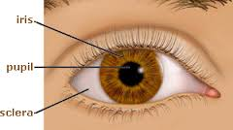
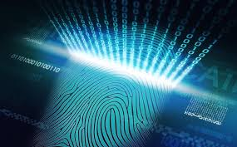

FEATUERES OF AADHAAR
12 digit unique number generated
randomly without any
intelligence.
Uniqueness ensured through
biometrics.

Slide 7
Project Cost
About Rs. 35 billion(Rs. 3500 crore) was spent on Aadhar program from the beginning (January-2009) till September 2013.
Budget allocated by Govt. for UID Project-
Year 2013-2014 - 1550 Cr.
Year 2014-2015 - 2039 Cr.
Source: www.thehindubusinessline.com

Slide 8
UIDAI PROJECT INCREASING
Efficiency
Delivery
Transparency

Slide 9
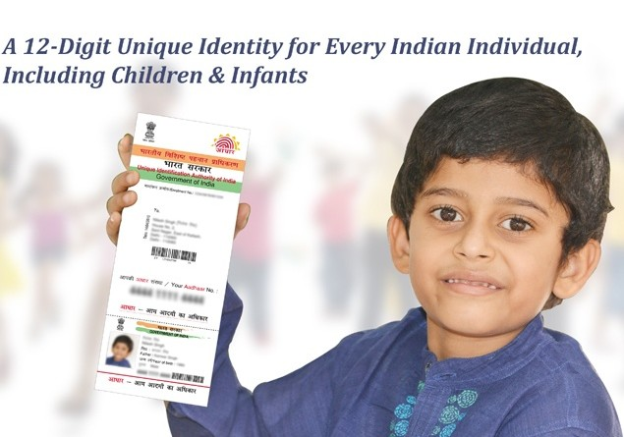
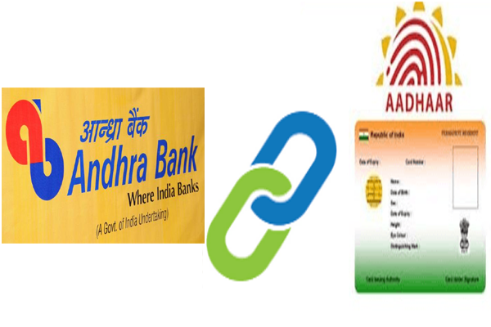
Ensures one beneficiary has one number across subsidy programs.[EFFICIENCY]
Enables real-time authentication of identity at the time of subsidy delivery.[Transparency]
Fully electronic service delivery.
Enables delivery of welfare benefits and subsidies through direct transfers into Aadhaar enabled Bank Accounts (AEBA) using the Aadhaar Payments Bridge.[DELIVERY]

Slide 10
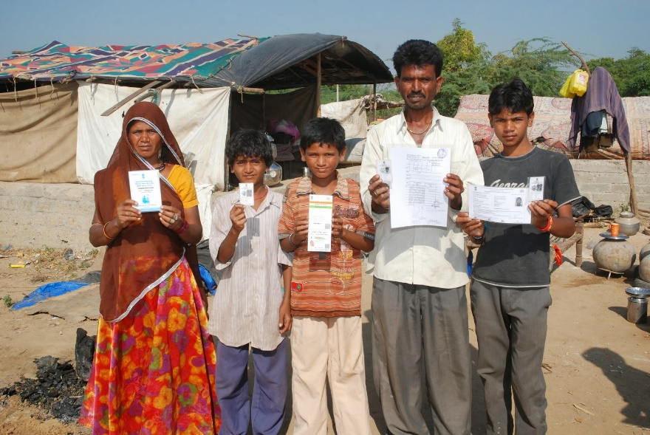
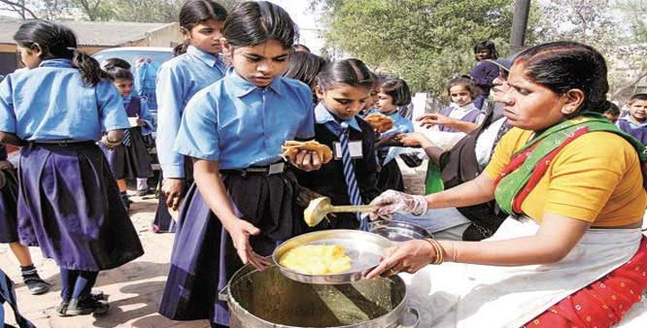
The benefits arise from the reduction in leakages that occur due to identification and authentication issues.
Rural development .
Check daily outlay of goods/payments
(e.g.: Mid-Day Meals, MGNREGS wages) to residents With Aadhaar

Slide 11
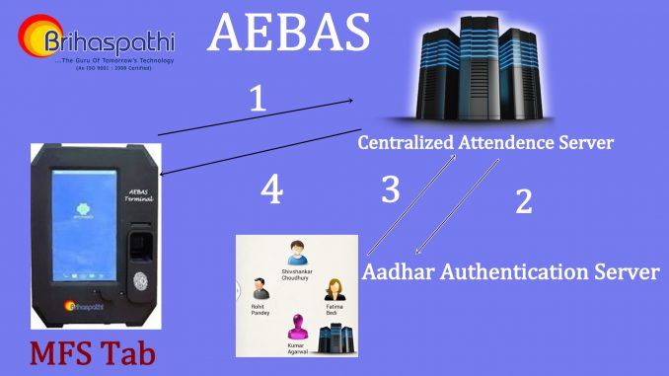
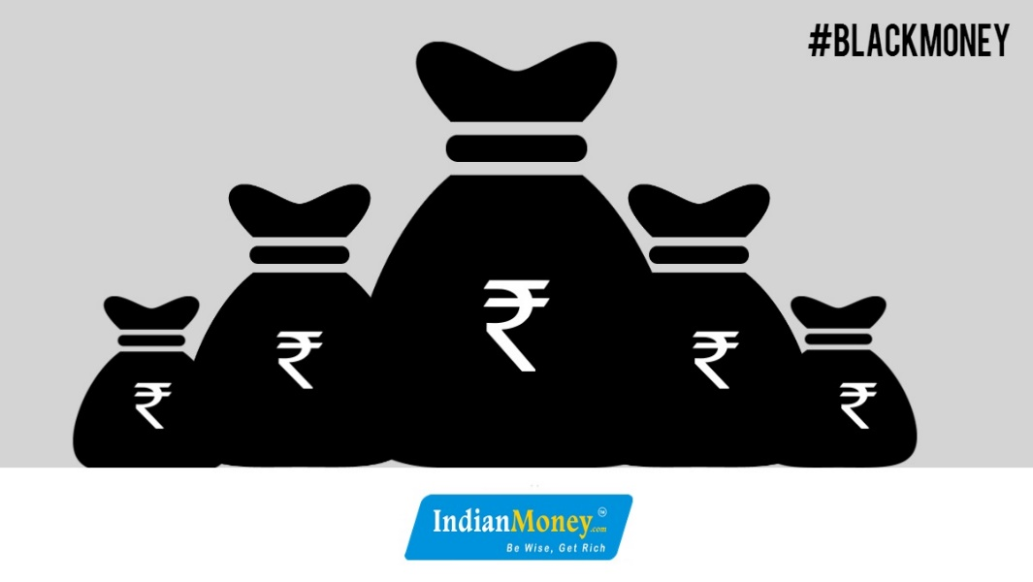
Moniter Attendance of civil servants
Reduce the Corruption.
Curb the Black money.
Stopping illegal immigration in India.
Fighting Terrorism and Crime, Improving Security.

Slide 12
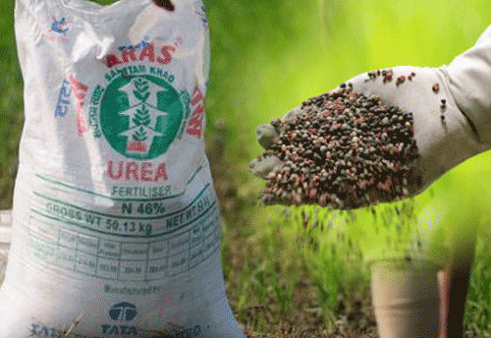
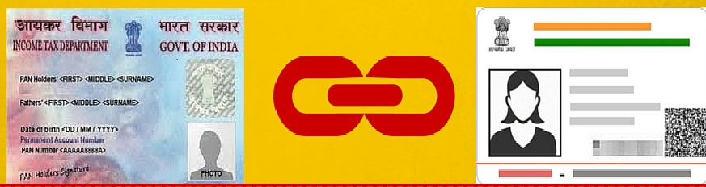
Use of Aadhaar authentication for e-verification of Income Tax Return.
Reduced beneficiary harassment and bribing due to reduced dependency on manual processes.
Provides end-to-end visibility of transactions to government ministries/departments to beneficiaries.
Aadhaar fertilizer subsidy .

Slide 13
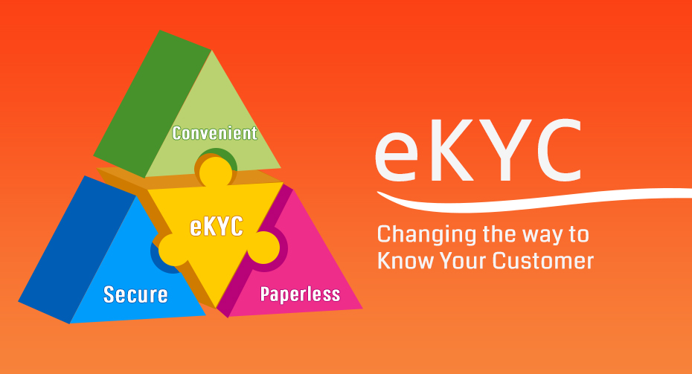
Aadhaar Enabled Services
e-KYC - Use of Aadhaar authentication for providing banking services .The UIDAI is transforming the entire KYC (know your customer) process by making it paperless, instantaneous, secure, economical through electronic medium.
Since, the service is paperless and fully electronic, document management can be eliminated.

Slide 14
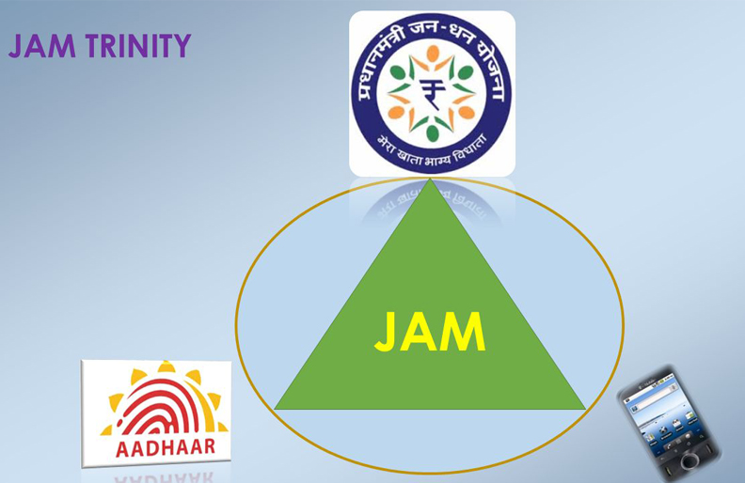
JAM –(Jandhan Aadhaar & Mobile)
launched by PM.Narendra Modi on 28th august 2014.
link the JanDhan account with aadhaar card & mobile number of Indians to plug
the leakages of govt. subsidies.(Provide OTP verification facility)

Slide 15
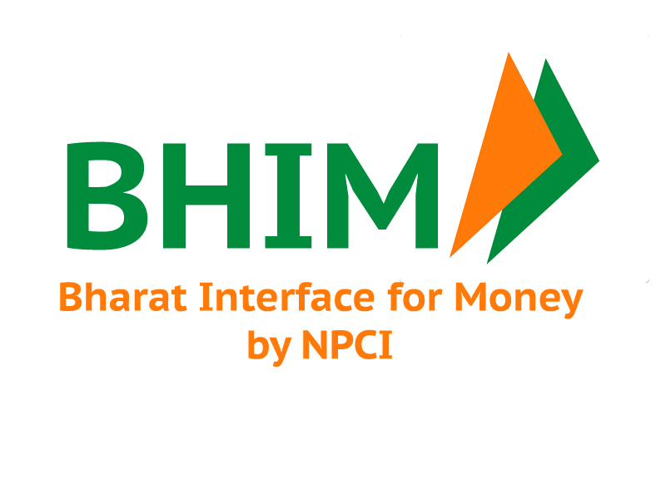
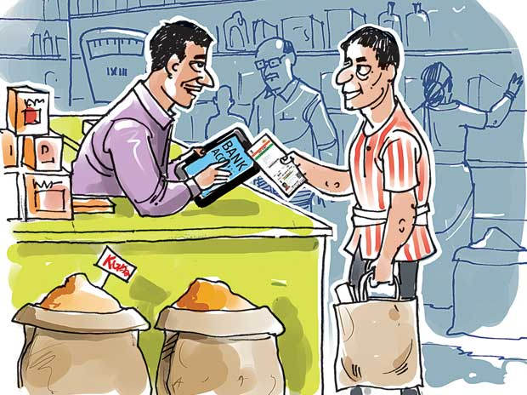
BHIM (Bharat Interface for Money)
BHIM allow users to send or receive money to other UPI payment addresses or scanning QR code or account number.
Users can create their own QR code for a fixed amount of money, which is helpful in merchant — seller — buyer transactions.

Slide 16
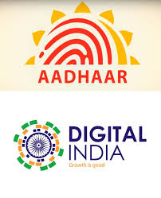
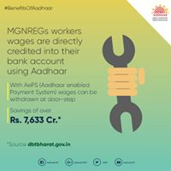
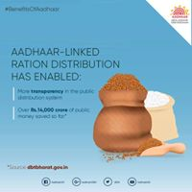
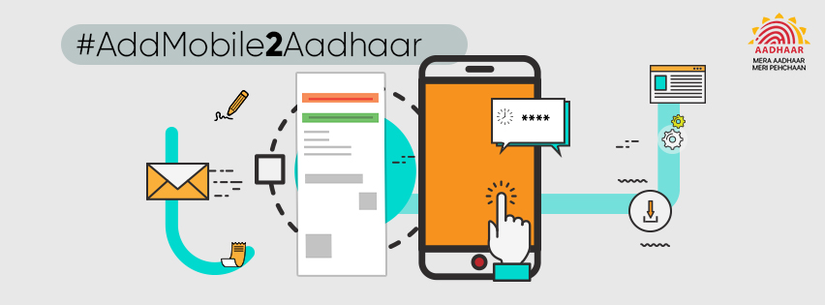
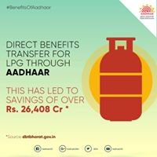
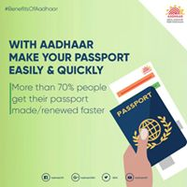
AADHAR Enabled Services

Slide 17
BENIFITS
For residents: The UID ­enabled Bank Account (UEBA) will bring financial access and affordability to millions of residents who are presently excluded from formal financial systems.
For the government: Large ­scale financial inclusion can pave the way for electronic benefit transfers (EBTs) for residents.
For banking institutions: The use of the central payments switch to move cash electronically at the last mile will dramatically cut down on cash handling and transaction costs for banking institutions.

Slide 18
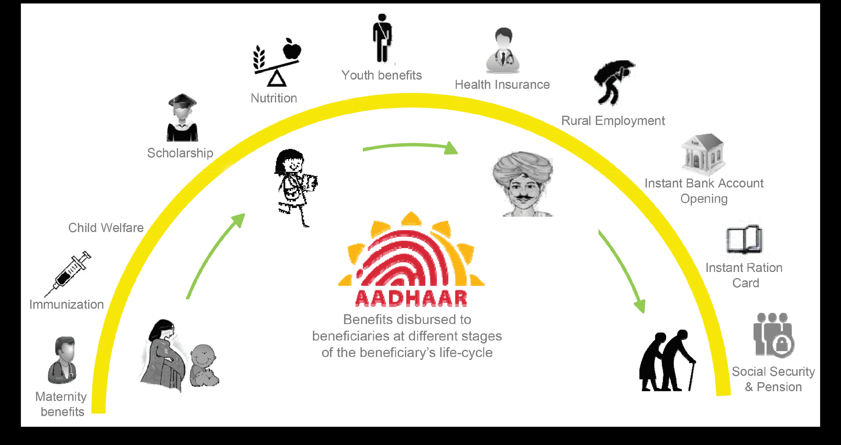

Slide 19
Challenges
Technical Risks:
Unstable biometrics.
Inability to handle huge number of transactions per
second.
Errors in data recording and data compilation.
External Risk:
Sharing of personal data with a non-trustworthy party.
Political risk..

Slide 20
Challenges Cont…
Managing difficulties in address verification, name standards, lack of information on date of birth, and hard to record fingerprints.
Many beneficiaries get excluded because they are unaware of the scheme or are unable to enrol for aadhar.
Sustainability risks: The economic model for the UIDAI will have to be designed to be sustainable in the long term, and ensure that the project can adhere to the standards mandated by the Authority

Slide 21
CONCLUSION
India will be the first country to implement a biometric-based unique ID system for its residents on such a large scale.
Serves as a universal proof of identity, allowing residents to prove their identity anywhere in the country
Enable government to target and deliver services effectively, achieve greater returns on social investments, and resource flows across the country.

Slide 22
CONCLUSION Cont…
Timing of this initiative is encouraging-
The creation of the UIDAI coincides with growing social investment in India. The spread of IT and mobile phones, which has made the public receptive to technology-based solutions
Costly Project.
Difficult to Authenticate the Person.
Risk of Privacy Leakage.
Maintenance of Database is difficult.

